Slide 1


CSB4301 – Theory of Computation
B.Tech – IVth Semester
Mr. D.S.John Deva Prasanna AP(SG) & Ms.Vanathi, AP,CSE
Department of Computer Science and Engineering

Slide 2
Converting ε NFA to DFA
We have converted ε NFA to NFA
In this session we are going to convert ε NFA to DFA
The DFA derived from the ε NFA both will accept the same Language(i.e same set of Strings).

Slide 3
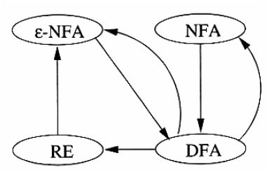
Conversion Possibilities

Slide 4
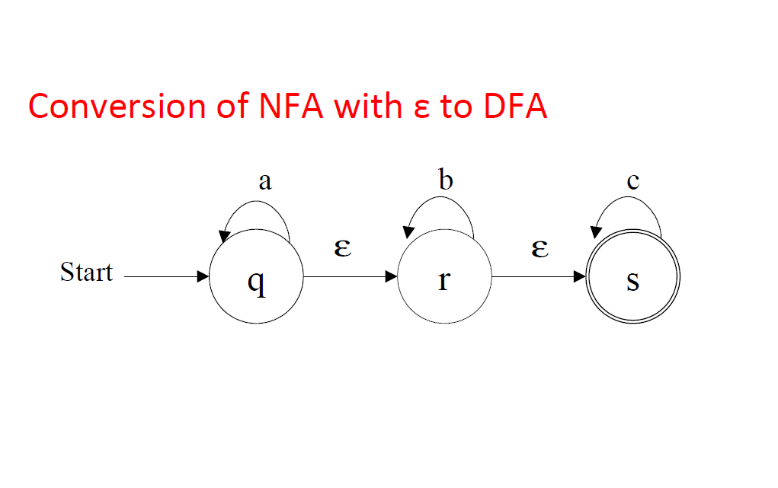

Slide 5
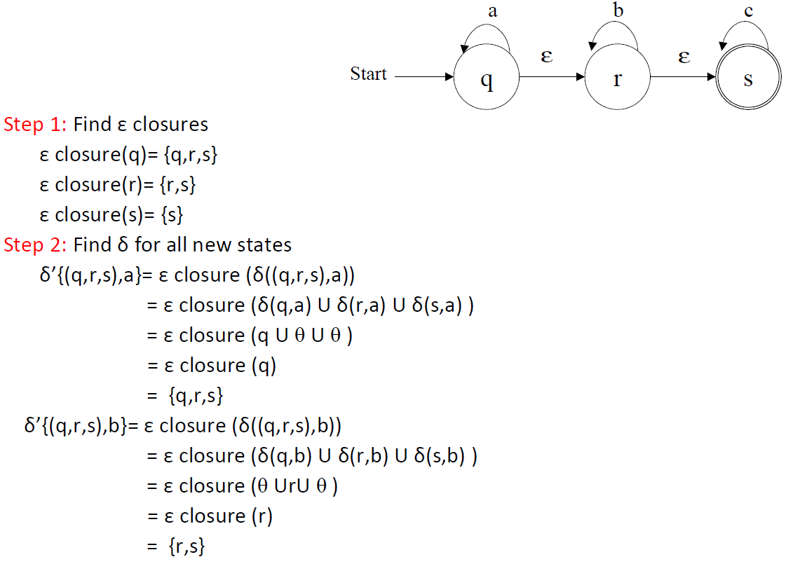
Converting ε NFA to DFA

Slide 6
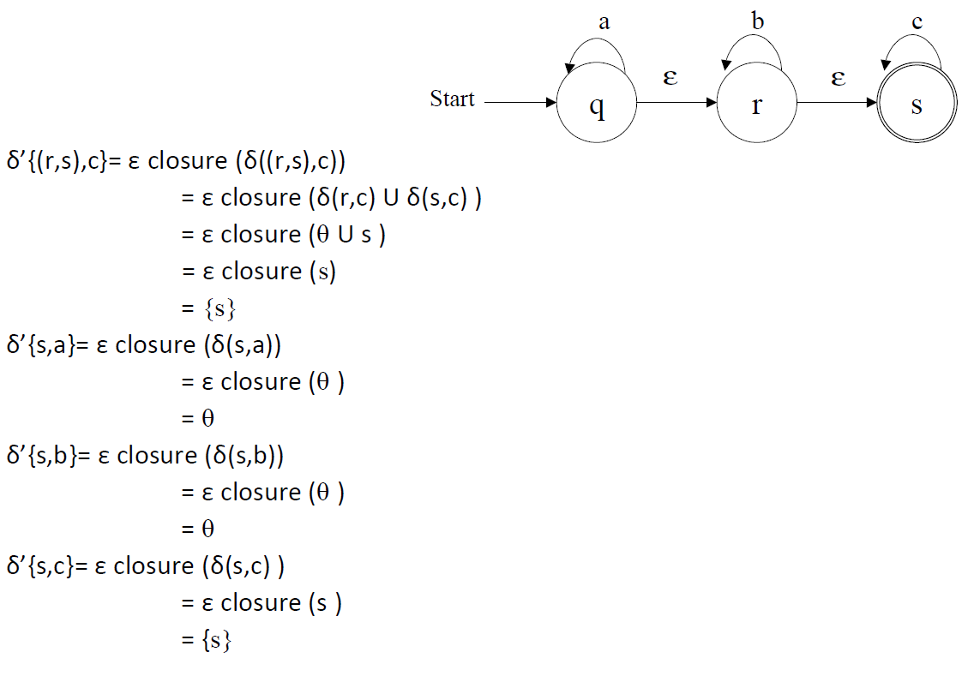
Converting ε NFA to DFA

Slide 7
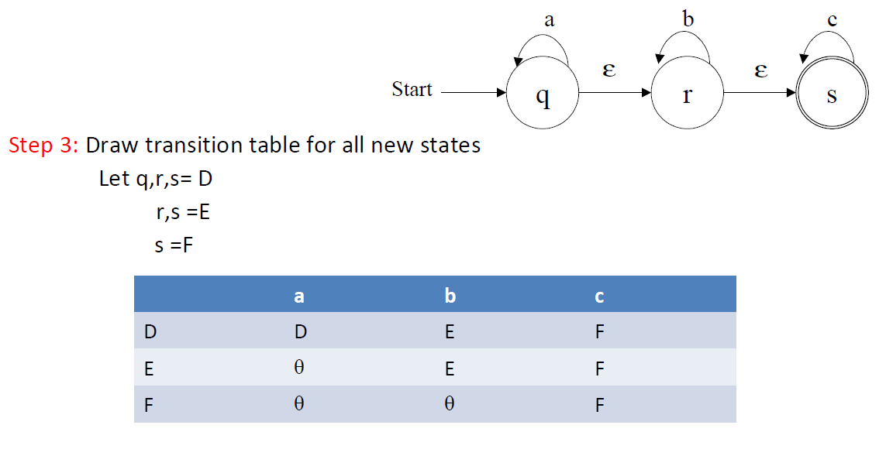
Converting ε NFA to DFA

Slide 8
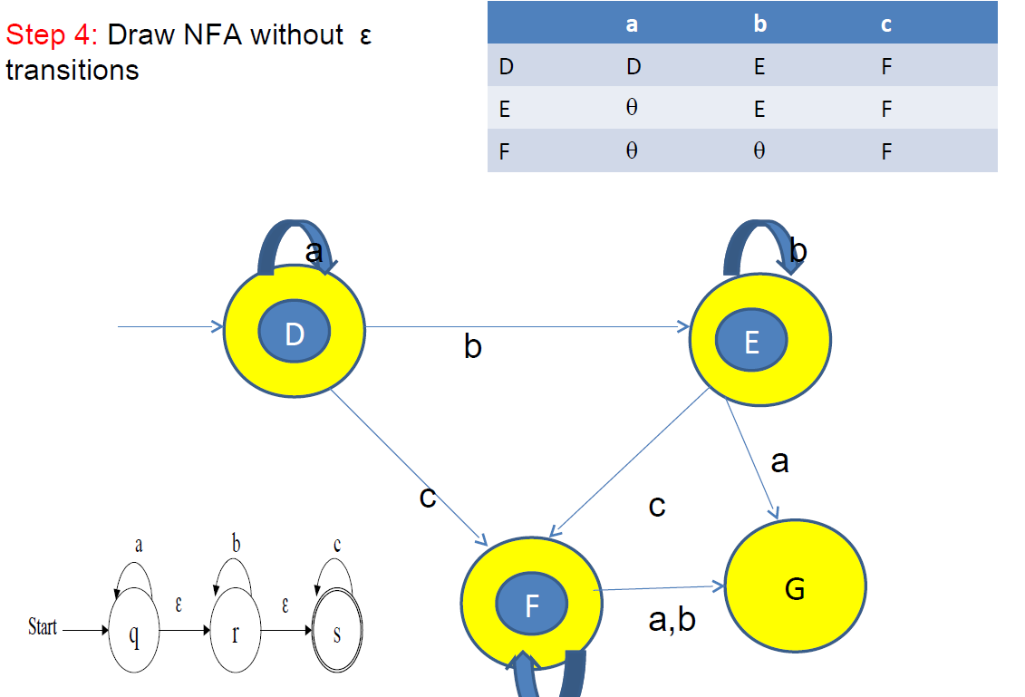
Converting ε NFA to DFA

Slide 9
Thank You

Slide 10
Thank You

Slide 11
Thank You

Slide 12
Thank You

Slide 13
Thank You

Slide 14
Thank You

